Slide 1


Route Optimization with Emission
FedEx SMART Hackathon
Name: Arjun Sasikumar
GitHub link: https://github.com/83Gh0st/route-optimizer

Slide 2
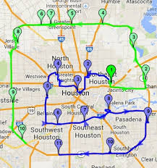
Problem Overview:
The increasing environmental concerns due to vehicle emissions are becoming a global issue.
Route planning systems often overlook the environmental impact of different vehicles.
Weather conditions such as temperature, humidity, and storms can drastically affect travel times, comfort, and safety.
Need: A solution that optimizes routes not only for time and distance but also for eco-friendliness (emissions) and safety (weather).

Slide 3

Objective: To create a web-based platform that:
Optimizes Routes: Using real-time data to find the best driving routes.
Calculates Emissions: Estimates the CO2 emissions for each route based on the vehicle type.
Visualizes Weather Data: Displays current weather information for both origin and destination.
Supports Decision Making: Allows users to choose routes that minimize emissions, taking weather conditions into account.

Slide 4


Technologies Used
Frontend: Streamlit
A Python framework to build interactive web applications quickly.
Backend: Python, External APIs
OSRM: Open Source Routing Machine for calculating real-time routes.
OpenWeatherMap: API for fetching real-time weather data.
Mapping: Folium
Interactive maps for route visualization and displaying markers for origin, destination, and weather info.
Data Visualization: Plotly, Matplotlib
For displaying charts of emissions and weather data to facilitate comparison.

Slide 5
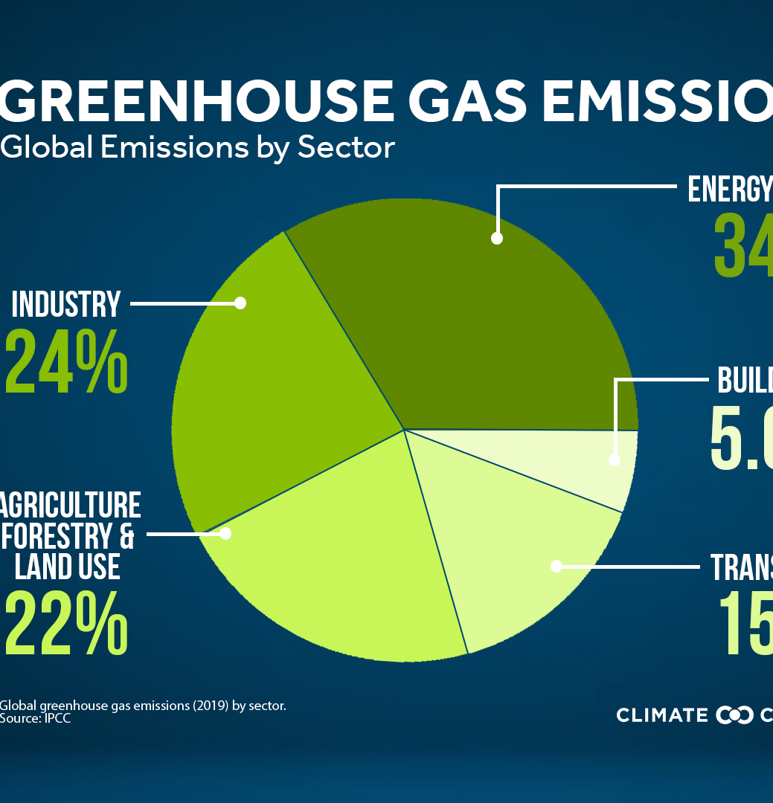
Architecture Overview
User Input:
Starting point, destination, vehicle type.
Backend Process:
Step 1: Geocoding the input locations (using Nominatim).
Step 2: Fetching multiple routes using OSRM.
Step 3: Fetching weather data from OpenWeatherMap for the origin and destination.
Step 4: Calculating emissions based on vehicle type (electric, gasoline, or diesel).
Results Display:
Interactive route map with emission and weather details.
Emission comparison chart for different routes.
Weather comparison chart for the origin and destination.

Slide 6


Key Features
Route Optimization:
Multiple routes are provided with estimated travel times, distances, and alternative paths.
Emission Calculation:
For each route, emissions are calculated based on vehicle type, and the best route can be chosen based on this metric.
Weather Forecast:
Real-time weather data is fetched for the origin and destination, including temperature, humidity, and weather conditions.
Map Display:
A dynamic map shows the routes, along with markers indicating weather at each key location.

Slide 7
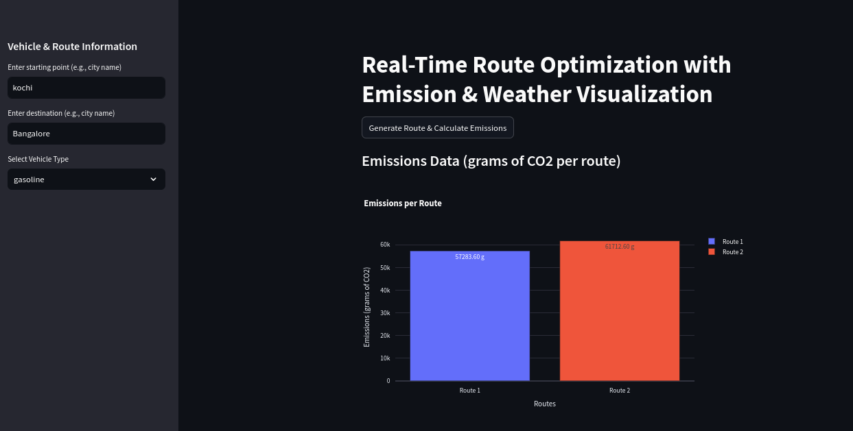
Emission Calculation Formula
Emission Formula:
Emissions are calculated as follows: Emissions=Distance (km)×Emission Factor (g/km)/{Emissions} = {Distance (km)} *{Emission Factor(g/km)}Emissions=Distance (km)×Emission Factor (g/km)
Emission Factors:
Electric: 0 g CO2/km
Gasoline: 120 g CO2/km
Diesel: 150 g CO2/km
Example Calculation:
If the route is 100 km and the vehicle is gasoline, the emission will be 100×120=12,000g CO2100 \times 120 = 12,000 \text{g CO2}100×120=12,000g CO2.

Slide 8

Challenges Faced
Challenge 1: API Rate Limiting
Handling delays or restrictions in API calls, especially with services like OSRM and OpenWeatherMap.
Challenge 2: Accurate Geocoding
Ensuring correct coordinates are fetched for vague or imprecise location names.
Challenge 3: Integrating Multiple APIs
Seamlessly fetching and combining data from different APIs (OSRM, OpenWeatherMap) into a unified user experience.

Slide 9

Results
Route Emissions: Emissions are calculated for each route, and the route with the least emissions can be selected for eco-friendly travel.
Weather Data: The current weather conditions at the origin and destination are provided to help users understand the weather conditions during their travel.
Map: The map displays alternative routes with visual details on emissions, weather, and travel time.

Slide 10

Future Enhancements
Enhancement 1: Real-Time Traffic Data
Integrate with live traffic data to further optimize routes in real-time.
Enhancement 2: Public Transportation and Bike Routes
Include routes for public transport and biking to promote sustainability.
Enhancement 3: Intelligent Route Selection Based on Environmental Impact
To guide users in choosing the most eco-friendly route based on not only emissions but also factors like air quality and weather conditions.

Slide 11

Thank you
The application provides a comprehensive solution to route optimization by considering both emissions and weather data.
It helps users make eco-friendly travel decisions, while also ensuring their safety and comfort with weather forecasting.
The solution showcases the power of combining real-time data and algorithms for practical, impactful applications.

